Slide 1
Data Mining

Slide 2
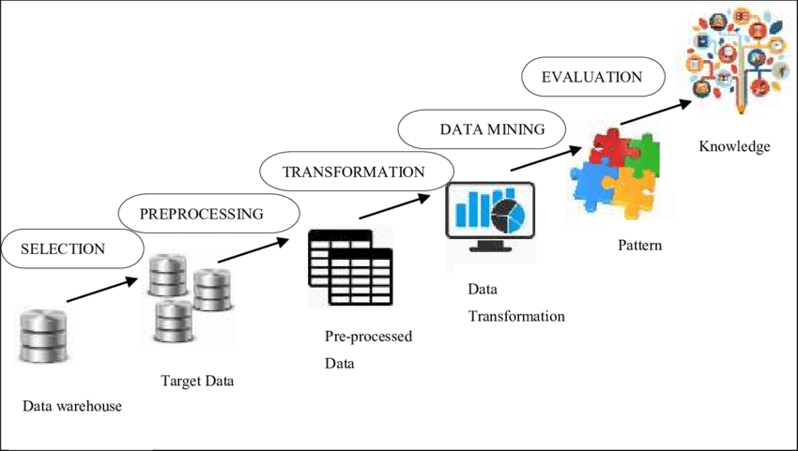

Slide 3
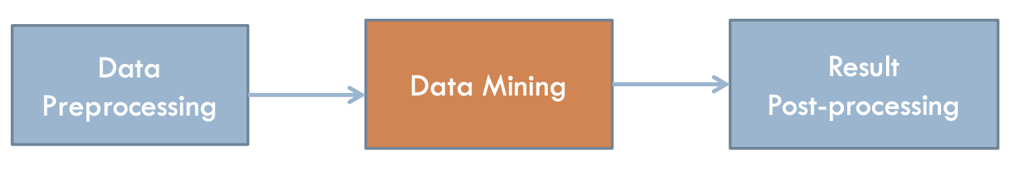
Preprocessing: Real data is noisy, incomplete and inconsistent.
Data cleaning is required to make sense of the data
Techniques: Sampling, Dimensionality Reduction, Feature Selection.
Post-Processing: Make the data actionable and useful to the user :
Statistical analysis of importance & Visualization
The Analysis Pipeline

Slide 4
Data Preprocessing
Feature Values
Feature Transformation
Normalization (Standardization)
Aggregation
Discretization
Sampling
Dimensionality Reduction
Feature subset selection
Distance/Similarity Calculation
Visualization

Slide 5
Feature Values
Data is described using attribute values

Slide 6
Feature Values
Data is described using attribute values
Attribute values are numbers or symbols assigned to an attribute
Distinction between attributes and attribute values
Same attribute can be mapped to different attribute values
Example: height can be measured in feet or meters
Different attributes can be mapped to the same set of values
Example: Attribute values for ID and age are integers
But properties of attribute values can be different ID has no limit but age has a maximum and minimum value

Slide 7
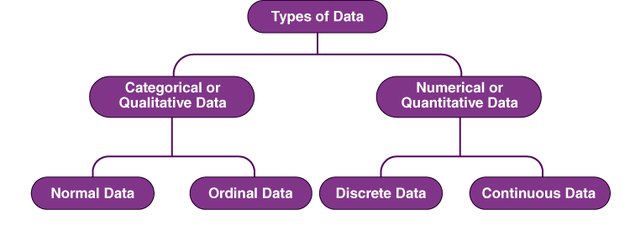
Types of Attributes

Slide 8
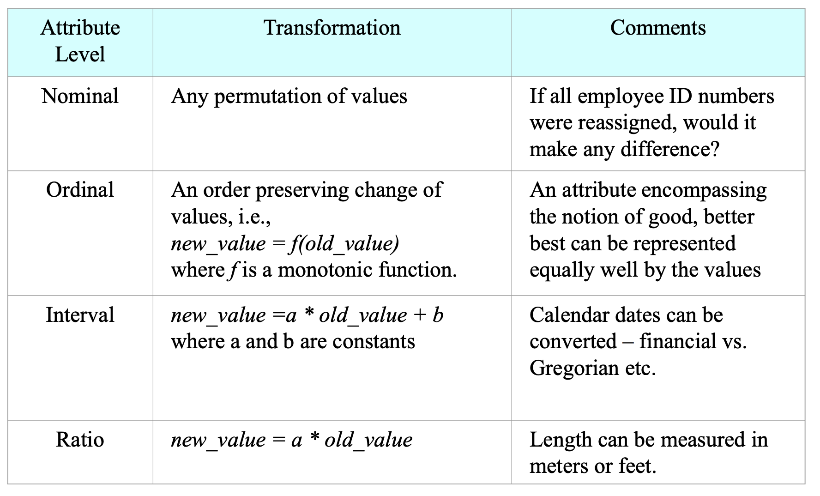

Slide 9
Discrete and Continuous Attributes
Discrete Attribute
Has only a finite or countable infinite set of values
Examples: zip codes, counts, or the set of words in a collection of documents Often represented as integer variables.
Continuous Attribute
Has real numbers as attribute values
Examples: temperature, height, or weight.
Practically, real values can only be measured and represented using a finite number of digits

Slide 10
Data has attribute values
Then, How good is our data w.r.t. these attribute values?

Slide 11
Data Quality

Slide 12
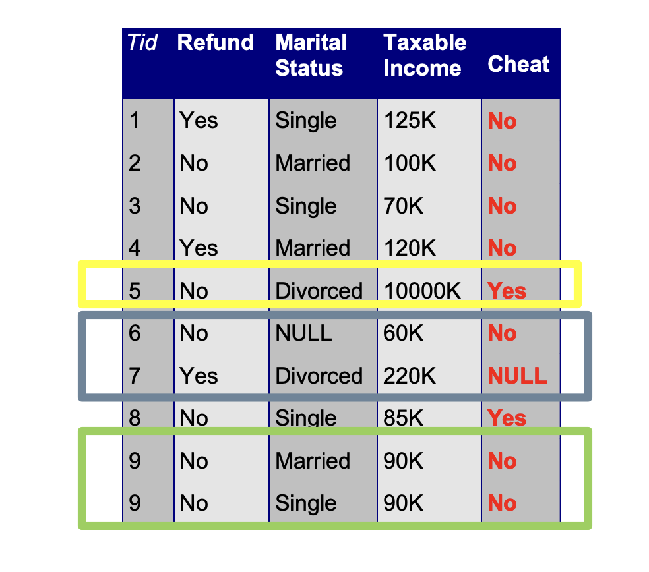
Examples of Data Quality problems:
Noise and outliers
Missing values
Duplicate data

Slide 13
Data Quality: Noise
Random Errors → Mistakes in data collection, entry, or transmission
Irrelevant Information → Data that does not contribute to useful patterns
Inconsistent or Incorrect Labels → Wrong labels in classification tasks
Duplicate or Redundant Data → Repeated or unnecessary records

Slide 14
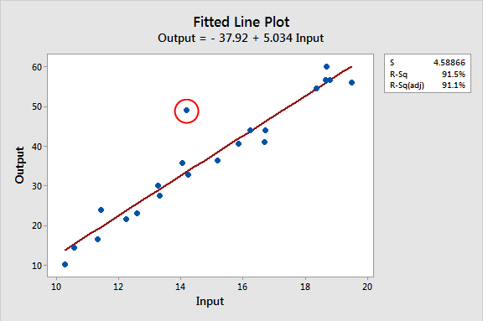
Data Quality: Outliers
Outliers are data objects with characteristics that are considerably different than most of the other data objects in the data set

Slide 15
Data Quality: Missing Values
Reasons for missing values
Information is not collected (e.g., people decline to give their age and weight)
Attributes may not be applicable to all cases (e.g., annual income is not applicable to children)

Slide 16
Data Quality: Missing Values
Handling missing values
Eliminate Data Objects
Estimate Missing Values
Ignore the Missing Value During Analysis
Replace with all possible values (weighted by their probabilities)

Slide 17
Data Quality: Duplicate Values
Data set may include data objects that are duplicates, or almost duplicates of one another
Major issue when merging data from heterogeneous sources
Examples: Same person with multiple email addresses
Data cleaning: Process of dealing with duplicate data issues

Slide 18
Data Quality: Handle Noise
Binning
Sort data and partition into (equi-depth) bins smooth by bin means, bin median, bin boundaries, etc.
Regression
Smooth by fitting a regression function
Clustering
Detect and remove outliers
Combined computer and human inspection
Detect suspicious values automatically and check by human

Slide 19
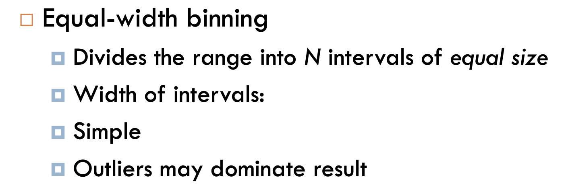
Data Quality: Handle Noise (Binning)

Slide 20
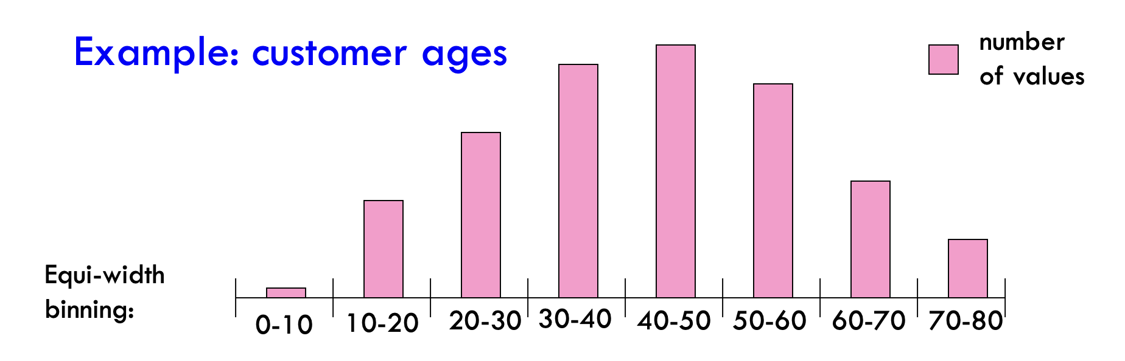
Data Quality: Handle Noise (Binning)

Slide 21
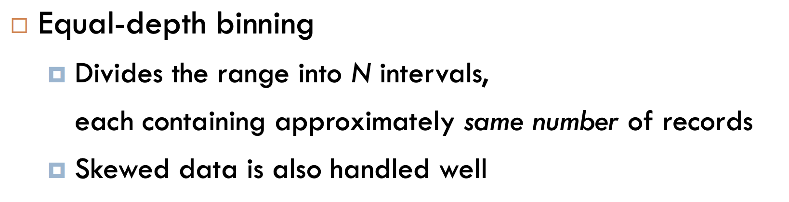
Data Quality: Handle Noise (Binning)

Slide 22
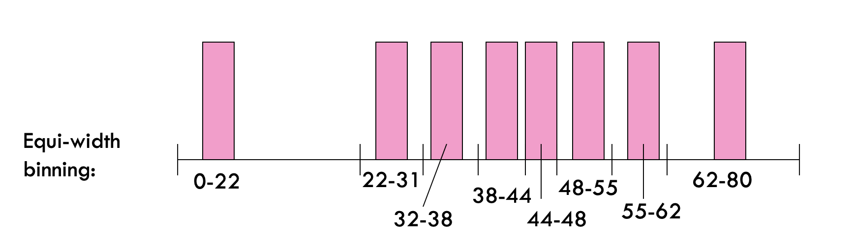
Data Quality: Handle Noise (Binning)

Slide 23
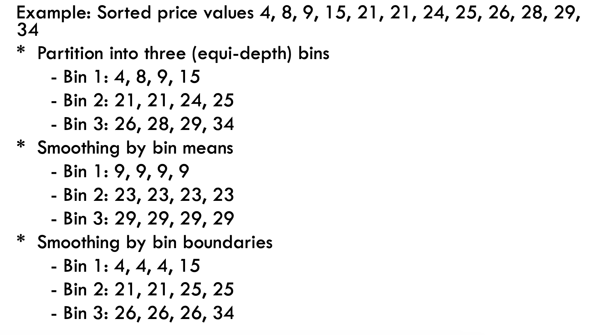
Data Quality: Handle Noise (Binning)

Slide 24
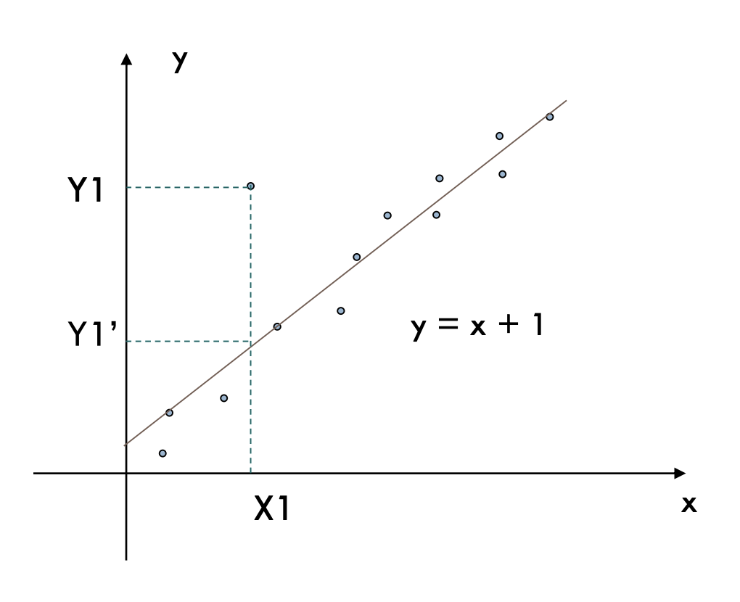
Data Quality: Handle Noise (Regression)
Regression helps smooth noisy data by fitting a mathematical function (e.g., linear or polynomial regression). The function predicts values, reducing fluctuations.

Slide 25
Raw Data (with noise):
(1, 100), (2, 102), (3, 250), (4, 108), (5, 110)
Fit a regression function (y = 2x + 98)
Predicted values: (1, 100), (2, 102), (3, 104), (4, 106), (5, 108)

Slide 26
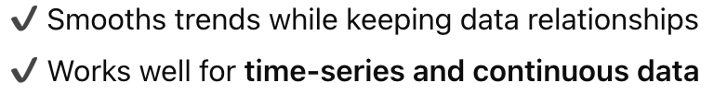
Raw Data (with noise):
(1, 100), (2, 102), (3, 250), (4, 108), (5, 110)
Fit a regression function (y = 2x + 98)
Predicted values: (1, 100), (2, 102), (3, 104), (4, 106), (5, 108)

Slide 27
How can we compare these attribute values?

Slide 28
Data Transformation

Slide 29
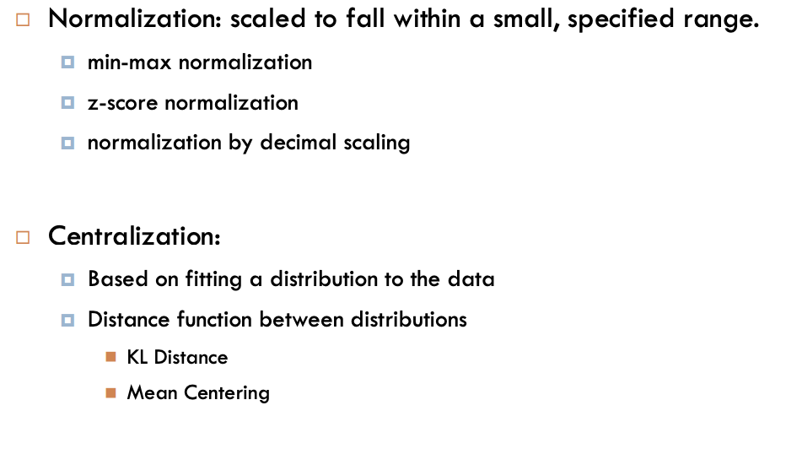

Slide 30
Normalization (Scaling Data within a Range)
Normalization transforms data so that values fall within a specific range (e.g., [0,1] or [-1,1]).
Crucial for machine learning models, as some models (like gradient-based algorithms) are sensitive to varying feature magnitudes.

Slide 31
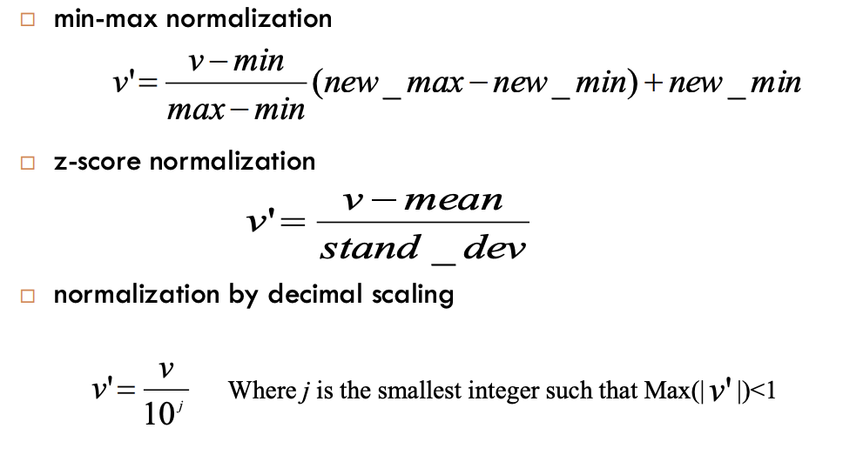

Slide 32
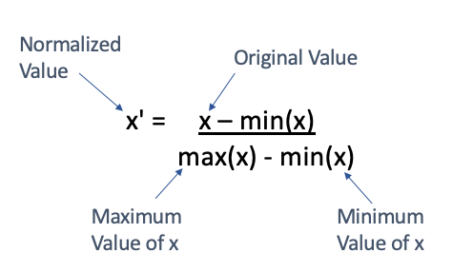
Min-Max Normalization
Range [0,1]

Slide 33
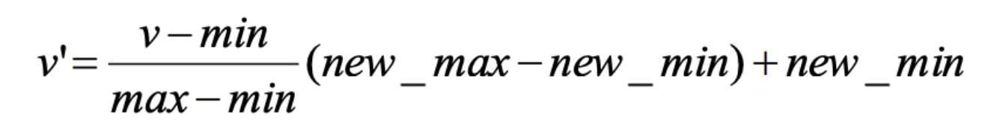
Converts data into a range [new min, new max] (commonly [0,1] or [-1,1]).

Slide 34
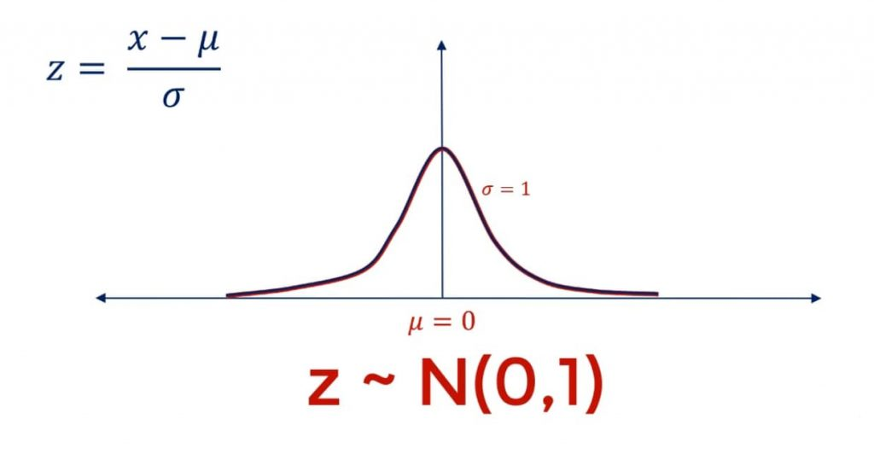
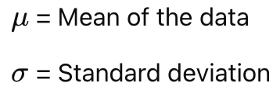
Standardization (Z-Score Normalization)

Slide 35
Converts data into a standard normal distribution with mean = 0 and standard deviation = 1.
Useful when data has different scales and distributions.
Less sensitive to outliers compared to min-max normalization.

Slide 36
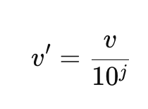

Decimal Scaling Normalization
Moves the decimal point to scale values within (-1,1).
The choice of j depends on the maximum absolute value in the dataset.
Simple but not commonly used in ML.

Slide 37
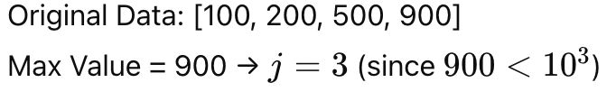
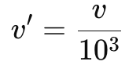

Decimal Scaling Normalization

Slide 38
Data Transformation: Aggregation
Combining two or more attributes (or objects) into a single attribute (or object)
Purpose
Data reduction
Reduce the number of attributes or objects
Change of Scale
Cities aggregated into regions, states, countries, etc
More “stable” data
Aggregated data tends to have less variability

Slide 39
Discretization
Discretization is the process of converting continuous numerical data into discrete categories or bins.

Slide 40
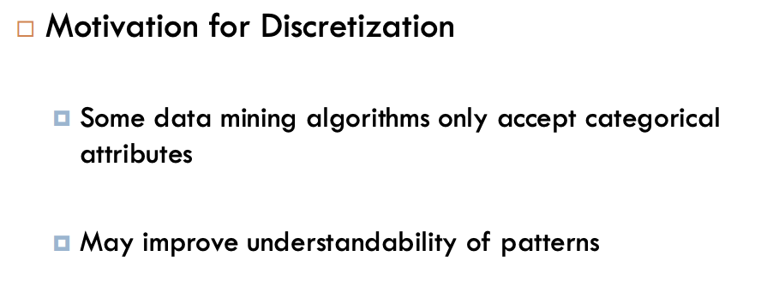

Slide 41
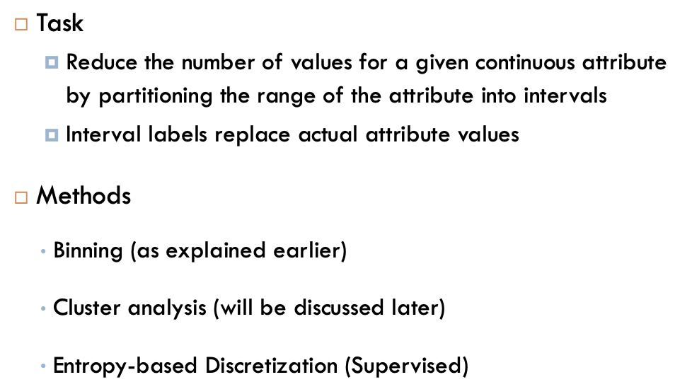

Slide 42
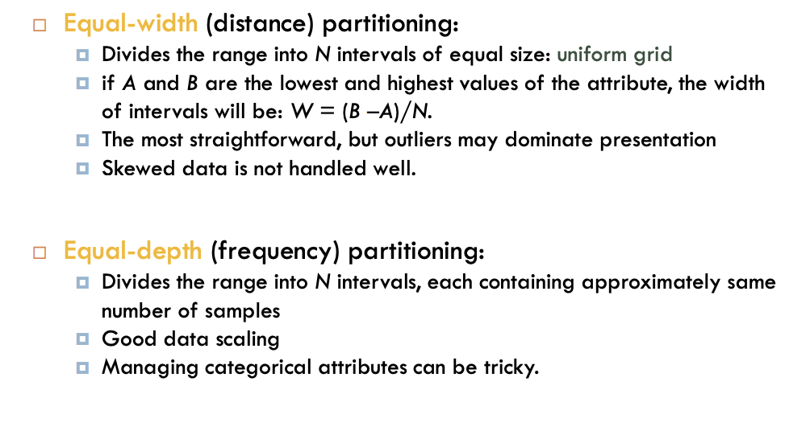
Simple Discretization Methods: Binning

Slide 43
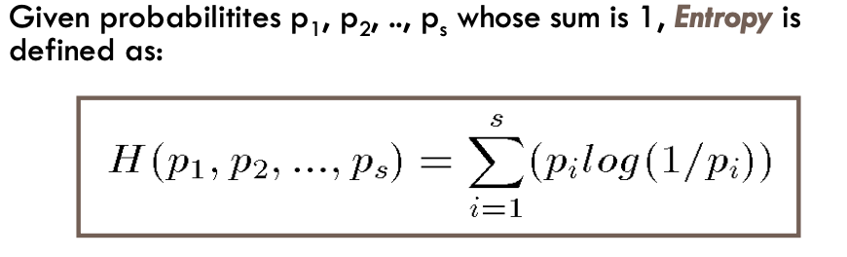
Information/Entropy

Slide 44
Information/Entropy
Entropy measures the amount of randomness or surprise or uncertainty. Only takes into account non-zero probabilities

Slide 45
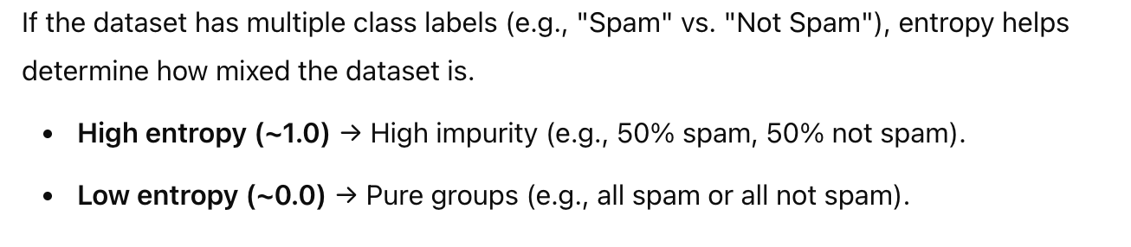
Information/Entropy

Slide 46
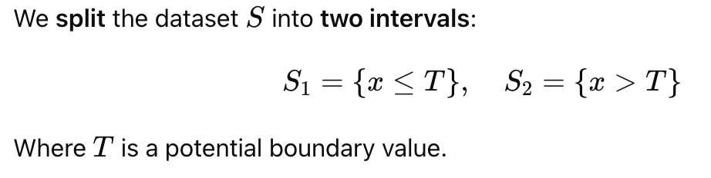
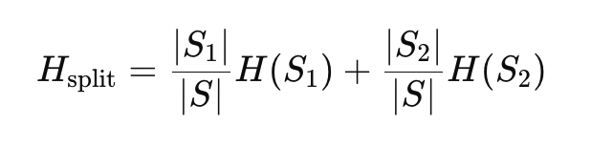
Information/Entropy

Slide 47

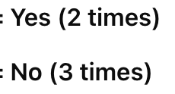
Age | Loan Approved
22 | Yes
25 | Yes
47 | No
51 | No
56 | No

Slide 48
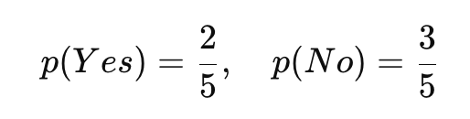
Age | Loan Approved
22 | Yes
25 | Yes
47 | No
51 | No
56 | No

Slide 49
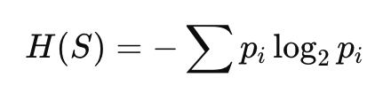
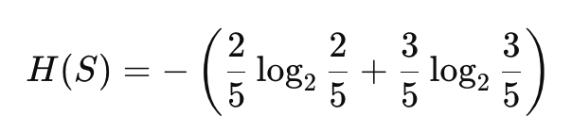
Entropy of the entire dataset S

Slide 50
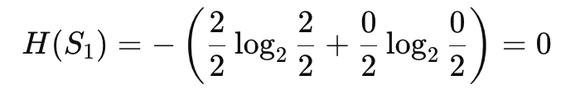
Entropy of the partition S1
Split at Age = 35
Age | Loan Approved
22 | Yes
25 | Yes

Slide 51

A (detailed) data preprocessing example
Suppose we want to mine the comments/reviews of people on Zomato.

Slide 52
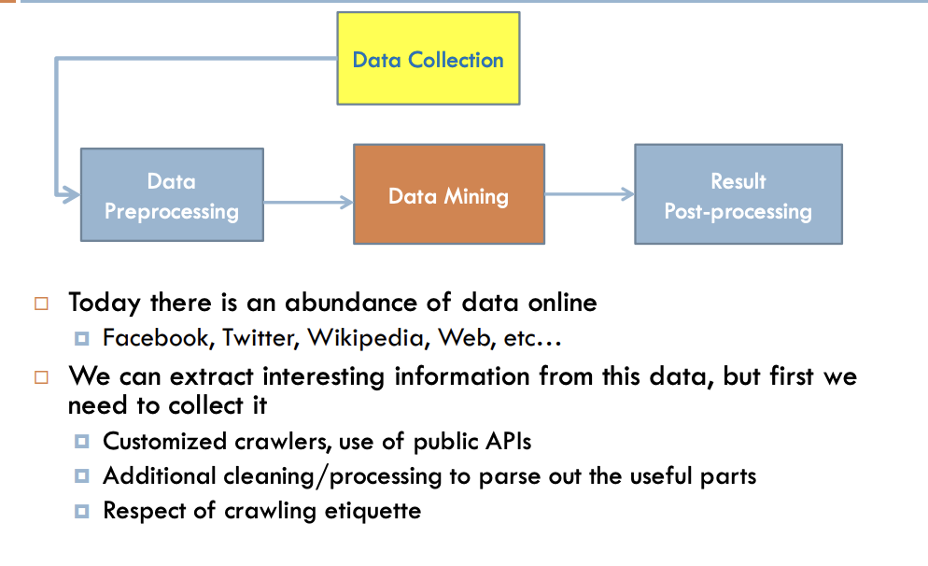
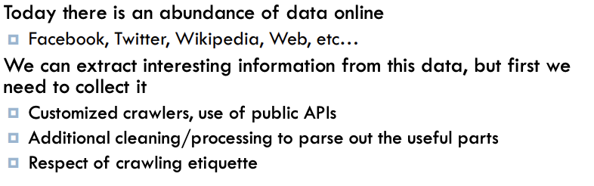

Slide 53
Example: Mining Task
Collect all reviews for the top-10 most reviewed places in Bangalore on Zomato
Find few terms that best describe the restaurants.
What Algorithm?

Slide 54
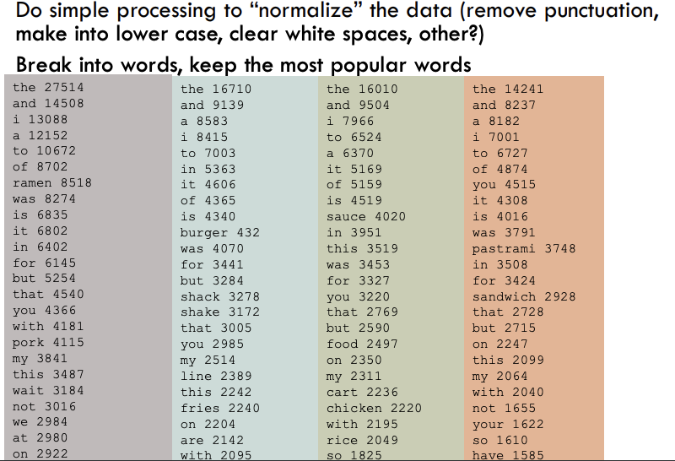

Slide 55
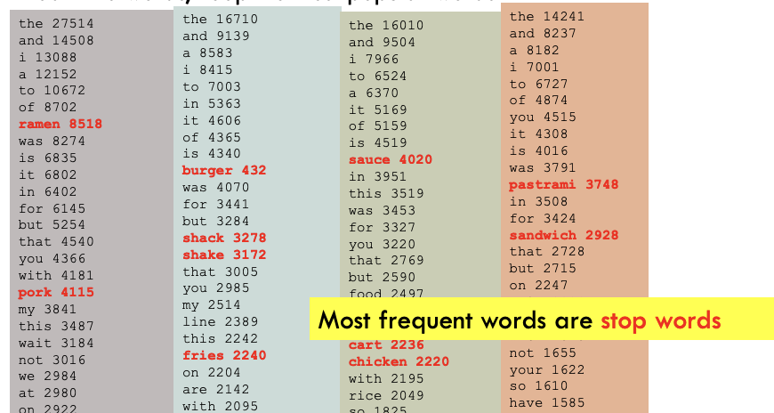

Slide 56
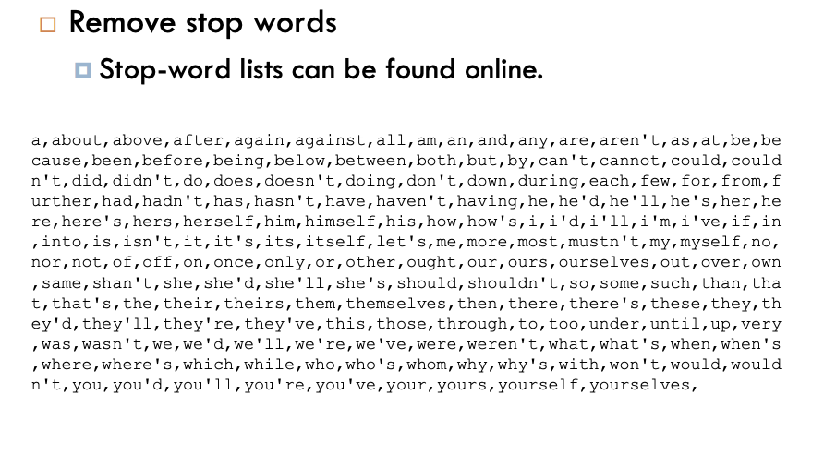

Slide 57
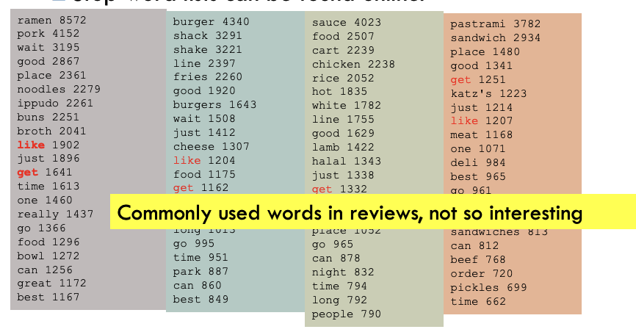

Slide 58
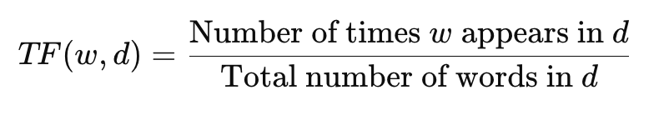
Term Frequency (TF)

Slide 59
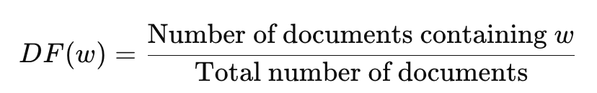
Document Frequency (DF)

Slide 60
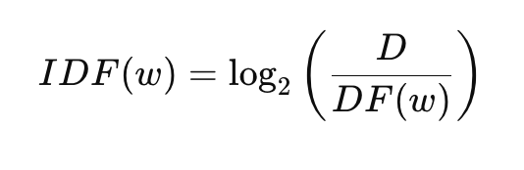
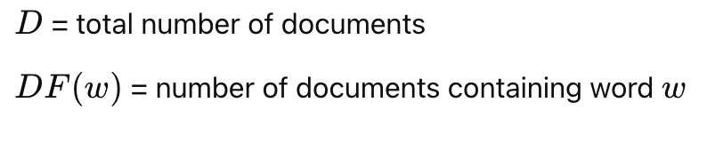

Slide 61
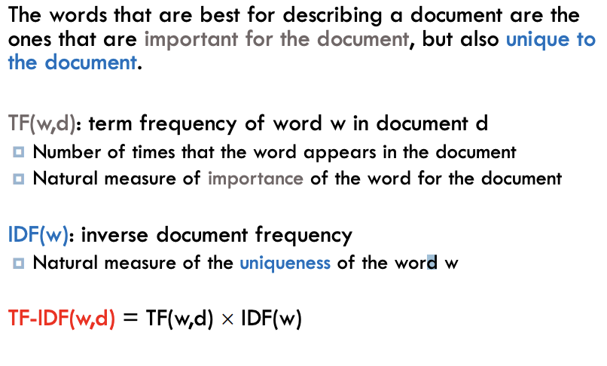

Slide 62
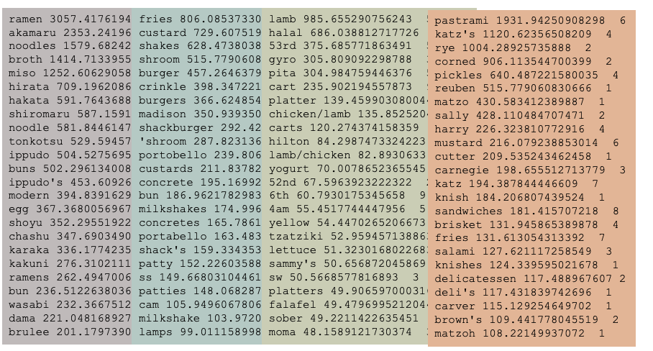
Ordered by TF-IDF

Slide 63
Ordered by TF-IDF
The higher TF-IDF score, more important the word

Slide 64
TF-IDF takes care of stop words as well
We do not need to remove the stop words since they will get IDF(w) = 0

Slide 65
Mining real data you often need to make some decisions
What data should we collect? How much? For how long?
Should we throw out some data that does not seem to be useful? Too frequent data (stop words), too infrequent (errors?), erroneous data, missing data, outliers How should we weight the different pieces of data?
Most decisions are application dependent. Some information may be lost but we can usually live with it (most of the times)
Dealing with real data is difficult

